Slide 1
Flexible and Effective measures - Market Base Approach -
Takashi Hongo
Senior Fellow
Mitsui Global Strategic Studies Institute

Slide 2
Modality of Measures
 | Reduction effect | Pros/Cons
Tax | △ (Indirect) | Tax revenue shall be allocated to the incentives for reduction at aviation sector Carbon cost is fixed.
Renewal of aircraft | ◎ | Reduction effect is continued. The best and principle solution. It takes time for delivery Initial cost is high
Route optimization | 〇 | Low cost option for airlines Inter-government coordination is needed.
Bio Fuel | ◎ | Technology innovation is needed. (cost reduction and quality control) Pay attention on Sustainability. (food and water shortage)
Offset Credit | ◎ (Indirect) | Generally low cost option Pay attention on the volatility of the market

Slide 3
Carbon Pricing – Carbon Tax / Mission Trading -
 | Outline | Price | CO2 emission
EU | ETS (from 2005) | EURO 3.78/ton(03/May) | 3,609
Japan | Carbon tax (from October 2012) | JPY 289/ton(after April 2016) | 1,138
US | California : ETS from 2013. Link with Quebec New York : ETS (RGGI) from 2009 | USD 10/ton or over USD 1.93/ton | 393 224
Canada | Quebec and Alberta : ETS British Columbia; Carbon tax | - CAD 30/ton | 318 63
Australia | Carbon tax form Oct.2012 ETS from July 2015. Link with EU ETS | AUD 23/ton - (Early shift is lobbied) | 546
Korea | ETS from 2015 | - | 495
China | 7 sub-national ETSs(experimental ) Plan to national scheme after 2016 | - | 1,443
India | Energy Efficiency Certificate trading(PAT) | - | 1,635
CO2 mission : million ton. Total of the above jurisdiction is 9,864 million ton and 33% equivalent of global CO2 emission

Slide 4
Lessons from Carbon Market
Volatility of carbon price
Fundamentals : Long term carbon price signal is crucial
However, market is often short sighted
Measurement should be simple and practical.
(both ETS and project base approach)
⇒“Benchmarking” is a practical and fair.
Still Learning by Doing stage

Slide 5
Scenario of International Framework - Pre and Post 2020 -
No-Cap
Scenario 4: Mostly Pledge &Review
Soft commitment
Scenario 3 : EU with Cap
US, Japan and BRICS
with Pledge & Review
Pledge &Review (Strong commitment)
Cap
Scenario 2 : Developed countries with Cap
BRICS with Pledge & Review
Scenario 1 ; All countries with Cap
Least Developing countries
Other
Developing
Developing
BRICS
US etc
US, Japan,
Canada etc
EU, Japan etc
EU, Australia etc

Slide 6
International Framework - Pre and Post 2020 -
Types of Offset Credit |  | Pros and Cons
Conventional Credits Under UNFCCC Allowance under national or sub-national scheme | CER, ERU, AAU EUA under EU ETS, other national, sub-national | Access is easy Affected by national environment policy Less space for CDM when coverage of ETS is enlarged.
New Credits |  | Flexible and preference of ICAO may reflected Big burden for implementing and managing own system
Ideas of New Credits
New credits | Outline
REDD+ | Forest conservation or restoration. Good public acceptance and contribution for bio diversity
CCS | Carbon Captured and sequestrated to underground. “Carbon free jet fuel.
Program Approach for offices or household | Like program CDM for energy saving Big reduction space and good public acceptance.

Slide 7
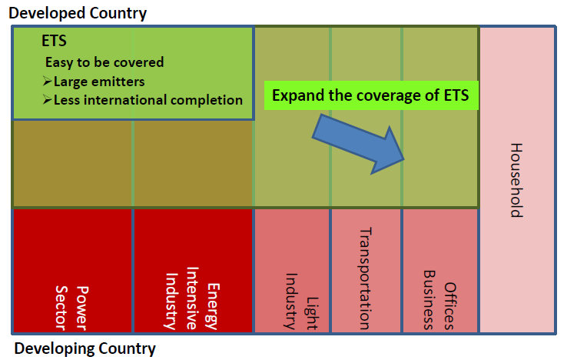
Enlargement of ETS – Squeezing the project base credits
Easy to be covered
Large emitters
Less international completion
Fields for
Project Base Credit

Slide 8
Japanese Measures - National, Sub-national Voluntary Actions -
Emission Reduction/ Carbon Pricing scheme | Outline
Regulation (national scheme) Measurement and reporting of CO2 emission Carbon Tax | “Act on the Promotion of Global Warming Countermeasures”. Emissions of installations are disclosed JAL: 3.8 million ton , ANA : 3.5 million ton (FY2009) Global Warming Tax from October 2012. Fossil fuel wholesalers pay tax and airlines pay carbon cost indirectly. Tax will be increased to JPY289/ton on April 2016
Regulation (sub-national scheme) Tokyo Emission Trading Scheme (Tokyo ETS) | 1st Phase (2010-2014):6-8%reduction 2nd Phase(2015-2019):15-17%
Voluntary Action Keidanren Action Plan | Voluntary reduction target. Electricity sector bough credits to meet the target. Use of offset credits has not been decided. The Scheduled Fight Association of Japan set the action program.

Slide 9
Airline under different regulations - Case of Japan -
Domestic Operation
International Operation
Japan (National Government)
ICAO
Other Jurisdiction
Reporting
(Pubic
pressure）
Reporting
&Carbon
Tax
Tokyo
Reporting
(Pubic
pressure）
Efficiency,
Tax, MBM
ETS
Fuel
Airport
Services
Fuel
Airport
Services
Cost
Airlines

Slide 10
Offset Credits for ICAO
Recommendation of
eligible credits
UN Credit
Independent Expert Committee
ICAO
Review of
Offset
Report of
Offset procedure
Determination
National Allowance
(EU, Australia etc.)
Offset
Airlines
Eligible
Criteria
National Offset credit (Japan etc.)
Sub-National allowance &offset credit (California, Quebec, China, Tokyo etc.)
Conditions of Eligible credits
Reliability – commercially and environmentally (avoid double counting)
Liquidity/Access to credits
Credits by regulations affects airlines
Options
REDD+ other new credits
Other credits

Slide 11
Conclusion - Recommendations
Varieties of options are better for sustainable growth of aviation sector.
Offset credit may be reasonable price option.
Own credits by ICAO is an option for keeping flexibility.
Voluntary actions leads to good public reputation.
Dialogue with market is recommended

