Slide 1
C2 Link
5 GHz Band Planning
- Status Update -
– RPAS Panel WG2 –
FSMP WG/12-IP/01 - Agenda 6 b)
4-15th October 2021

Slide 2
C2 Link 5GHz Band Planning - Background
    The 5030-5091MHz part of C Band is allocated to AM(R)S, AMS(R)S and ARNS on a co-primary basis
      Footnote 5.444, ICAO systems, MLS given priority in the 5030-5091MHz part of its allocation
      Footnote 5.443C, AM(R)S, ICAO systems, must protect RNSS in 5010-5030MHz
      Footnote 5.443D, AMS(R)S, ICAO systems, must be coordinated under 9.11A
    In September 2016 RTCA released a MOPS for a terrestrial C2 Link system operating in the 5030-5091MHz band
      In December 2020, the MOPS was updated (DO-362A) to include an airborne relay component
    In May 2018 EUROCAE invited comments on a draft MOPS for a geostationary satellite based C2 Link system operating in the 5030-5091MHz band

Slide 3
C2 Link 5GHz Band Planning – RTCA DO-362
    To avoid the need for expensive and bulky filtering, which would be required for FDD, DO-362 is based on a TDD waveform
      Air-to-Air and Ground-to-Ground interference cannot occur with TDD
      Filter rejection requirements for FDD would lead to significantly less useable bandwidth than the 61MHz of bandwidth that is available
      Filter size and weight constraints for FDD would counter low RF loss so impacting receiver performance and transmitter DC power efficiency
    A 50ms TDD frame was chosen to minimize the latency (e.g., for voice) and still not cause challenges with the fading dynamics of the terrestrial multipath propagation
      C2 Link recovers quickly after a fade
      Fading at the TDD rate does not typically occur during flight so no complex fast-fading tracker is required in the receiver

Slide 4
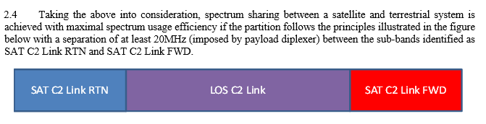
C2 Link 5GHz Band Planning – EUROCAE ED-265
    The service link between the RPA and satellite uses a 300msec TDD frame containing 5 (60msec) TDMA time slots
      The UA transmits and receives at different times so no diplexer is required
    The satellite to UA and UA to satellite links operate on different frequencies and the satellite uses a diplexer to separate the RTN and FWD transmissions for all of the RPA it supports in each spot-beam
From FSMP-WG/03-WP/10
From FSMP-WG/03-WP/10

Slide 5
C2 Link 5GHz Band Planning – Sharing
    So, given the different TDD time frames, the potential for Air-to-Air and Ground-to-Ground interference between the terrestrial and satellite equipped UA and ground systems exists
    Since no RF filtering is feasible, wideband noise from each system’s transmitters can be received by the other systems receivers
    A number of studies have been performed (in the FSMP, RPASP, EUROCAE and RTCA) to assess the frequency and spatial separations required to manage the interference to acceptable levels
      Different studies did not always use the correct or most up to date parameter values
      ED-265 receiver rejection increase will be required
    RPASP/ENAC recently completed its “final” study

Slide 6
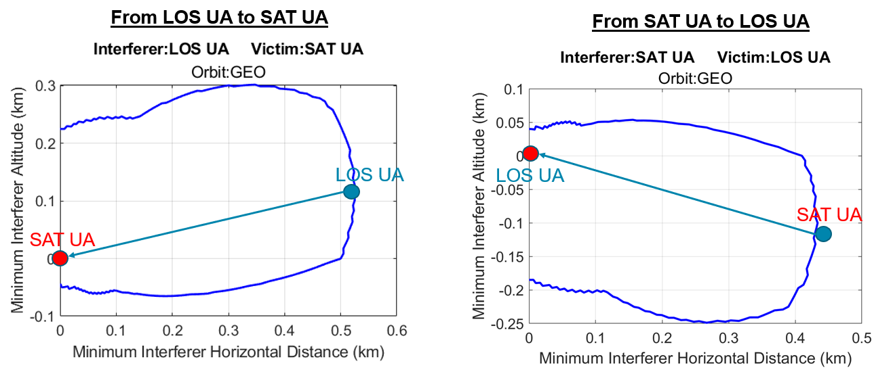
C2 Link 5GHz Band Planning – Sharing
Air-to-Air separations of 250m to 520m required between terrestrial and satellite equipped UA, assuming a frequency offset of > 2MHz

Slide 7
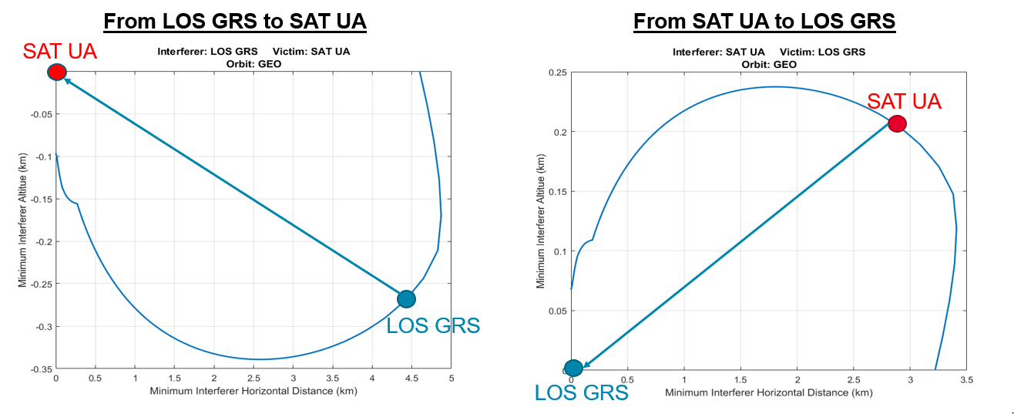
C2 Link 5GHz Band Planning – Sharing
Separations of 3km to 5km between satellite equipped UA and terrestrial ground stations required, if the satellite equipped UA operates below 240m to 350m, assuming a frequency offset of >2MHz

Slide 8
C2 Link 5GHz Band Planning – Sharing
    To mitigate the Air-to-Ground interference between satellite equipped UA and terrestrial ground stations the RPA could only use satellite when operating above 240-350m altitude
      May be necessary to use the lower latency terrestrial link for takeoff and landing
    However, this will require careful system design to ensure C2 Link continuity for both terrestrial and satellite systems to be installed on the same aircraft
      Does not resolve the more challenging Air-to-Air interference which TDD with a common frame timing would eliminate

Slide 9
C2 Link 5GHz Band Planning – Sharing
    Are these separations adequate?
    Aircraft are normally separated by at least 1,000 ft (300m) vertically and 3-5NM (5-8km) horizontally
    However, if those separations are lost RPAS rely on ATC instructions, Detect and Avoid Systems alerts and TCAS Resolution Advisories to mitigate the risk of collision
      ATC communicate with remote pilot using the UA’s VHF radio relayed through the C2 Link
      DAA target tracks sent over the C2 Link to the remote pilot
      In response to either input the remote pilot sends maneuver commands over the C2 Link to the UA
    All of these mitigations could be blocked if interference occurred
    RTCA is performing analysis to see how less effective the DAA system would be if the C2 Link was unavailable inside the separations determined in the sharing analysis

Slide 10
C2 Link 5GHz Band Planning – Sharing
    What can be done to reduce the separation requirements?
    Change the TDD time frames
      Increasing the terrestrial TDD frame time increases voice latency, which is already marginally complaint even on the terrestrial C2 Link
      Reducing the satellite TDD frame time, because of delay spread, reduces the maximum longitudinal offset between the satellite and the UA so more satellites are required
        RTCA DO-362A contains an example satellite link design that uses 50ms TDD, so is compatible with the terrestrial system, but it is limited to just cover the USA’s +/- 25 degrees longitudinal offset not the +/- 60 degrees that is desired by EUROCAE
    Use C/I+N rather than I/N in the analysis
      The terrestrial link operates at a high fade margin so at less than maximum range it has a robust C/N to combat interference
      The satellite link operates at a low fade margin and does not have an intra-system need for significant interference protection so has a limited C/N to absorb any interference

Slide 11
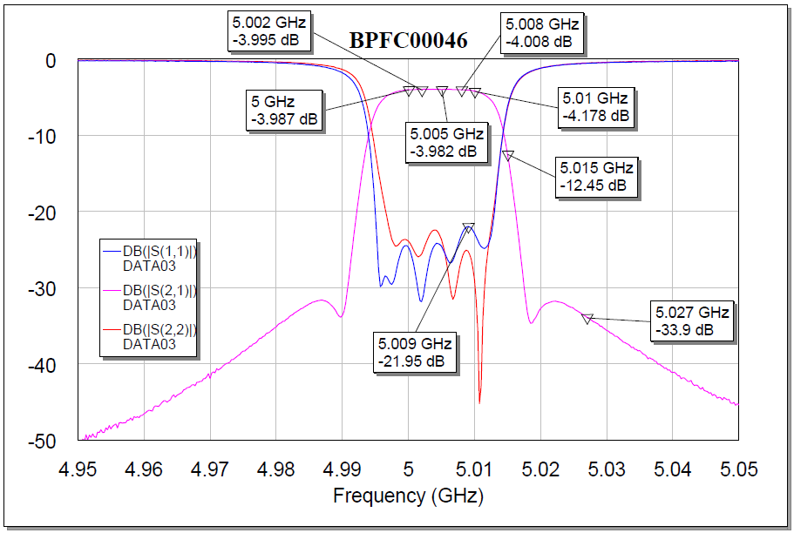

C2 Link 5GHz Band Planning – Sharing
    What can be done to reduce the separation requirements?
    Segment the allocation and impose RF filtering in the terrestrial and satellite RPA transmitters
    To provide a 10 times reduction in separation would require approximately 20dB of filter rejection with an approximately 4dB reduction in link margin
1.5kg and $5,000
10MHz passband, 25MHz stopband at -20dB
Approximately 30MHz of useable spectrum would be available in the 61MHz allocation

Slide 12
C2 Link 5GHz Band Planning – Sharing
    RPASP WG2 sees the 5030-5091MHz, AM(R)S/AMS(R)S allocation as a valuable C2 Link asset and wants to enable equitable access to both terrestrial and satellite solutions
    RPASP WG2 would value any feedback and suggestions from the FSMP on how to achieve that goal

